Slide 1



Lecture: Methods to validate fair classifiers
Authors:
Jose Caloca - Senior Data Scientist, ING Hubs Poland
Karan Gupta - Risk Modelling Expert, ING Hubs Poland
Disclaimer: The views expressed in this presentation and on the subsequent slides solely belong to the presenters and do not necessarily reflect ING practices.

Slide 2
Agenda
Let’s talk about models
Introduction to fairness
How to mitigate bias in models?
Questions?
Proceed to Codes
2

Slide 3

Let’s talk models

Slide 4
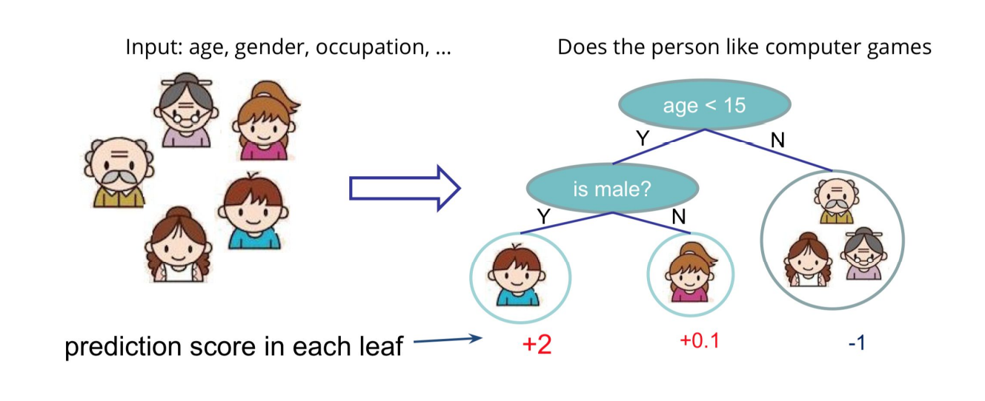
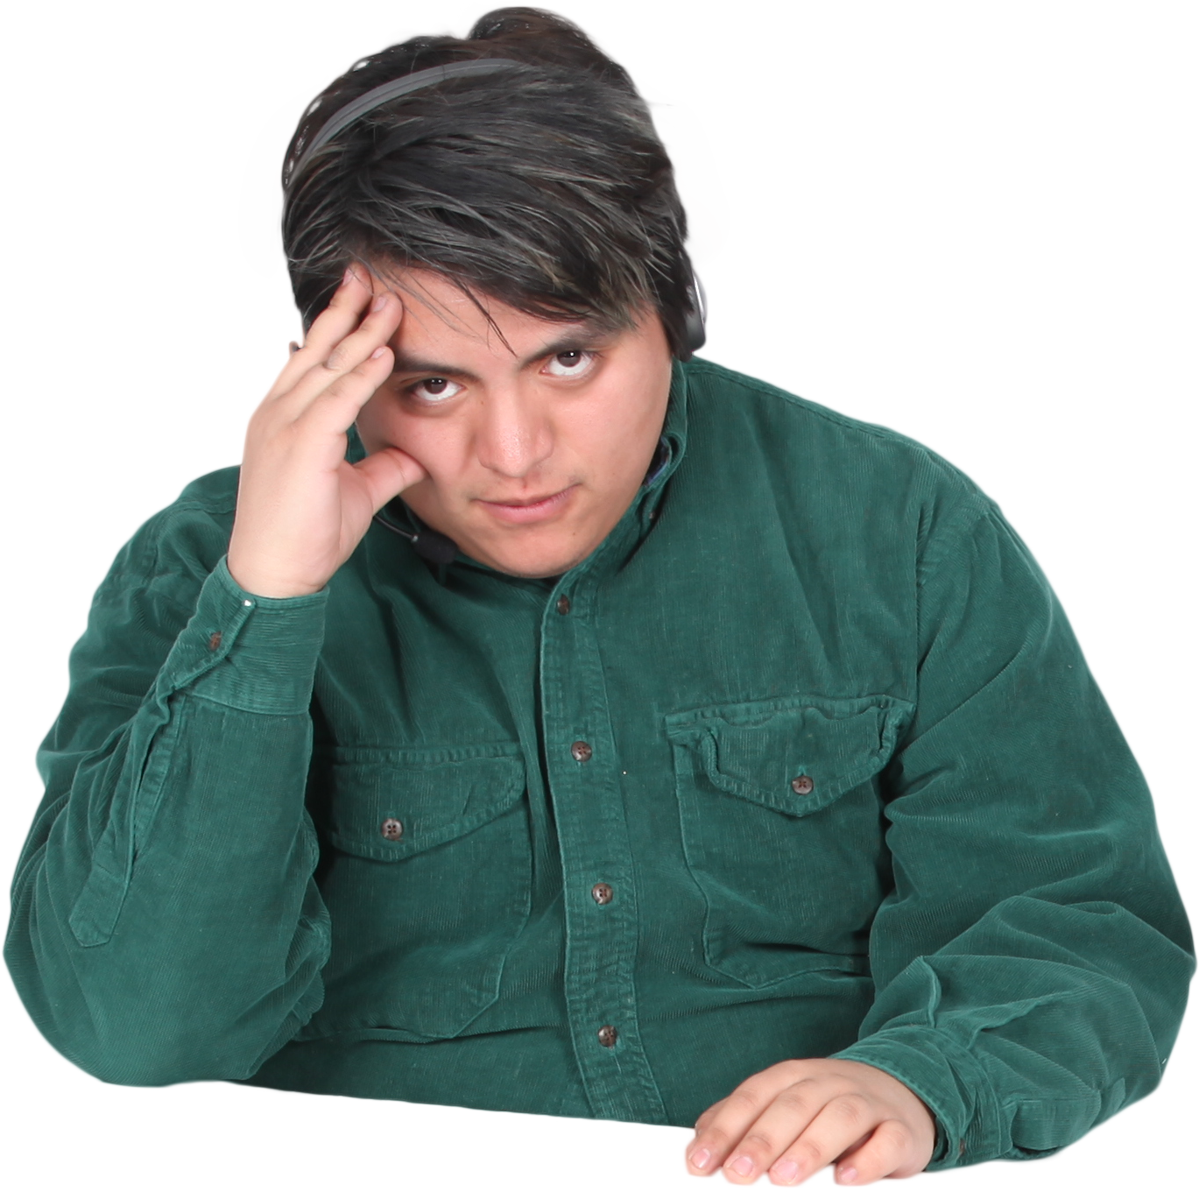
Model formulation – What do we do?
Banking context
Borrowers
LOANS
DEPOSITS
Savers
Money
Money
Interest
Giving out someone else’s money as a loan!
Banks answer this concern by estimating before hand the probability associated with losing money from a prospective loan.
$$PD=f\left(x\right);where x is customer attributes$$
4

Slide 5
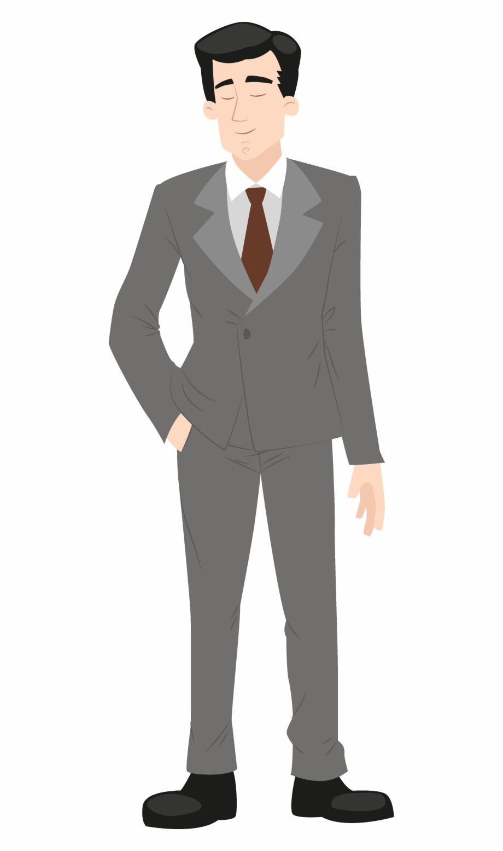


Model formulation – How do we use it? (1/2)
Customer
PD
Customer
PD
0.25
0.10
Rank ordering
0.10
0.25
0.35
0.35
UNRANKED
RANKED
5

Slide 6



Model formulation – How do we use it? (2/2)
Customer
PD
0.10
With this rank ordering of customers on the basis of their estimated risk, the bank has all it needs for making its decision:
It can apply an appropriate cut-off to make lending decision.
The applied PD cut-off would decide the approval rate at given observation point (say, in a month).
With this hypothetical cut-off, the approval rate would be 67%.
0.25
0.35
RANKED
6

Slide 7

Introduction to fairness

Slide 8





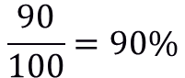
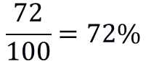
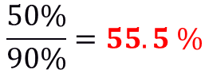
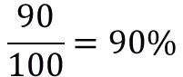
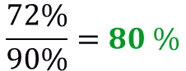
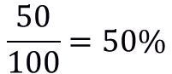
Model Fairness: How to think about it?
Think about the approval rates across different groups: for ex, females and males
What is adverse impact?
“Adverse impact is the negative effect an unfair and biased selection procedure has on a protected class. It occurs when a protected group is discriminated against during a selection process, like a hiring or lending decision.”
$$\frac{50}{100}=50\%$$
$$\frac{72}{100}=72\%$$
$$\frac{50\%}{90\%}=55.5 \%$$
$$\frac{72\%}{90\%}=80 \%$$
$$\frac{90}{100}=90\%$$
$$\frac{90}{100}=90\%$$
8

Slide 9



Model Evaluation: performance measure for models
Let’s take a detour to learn about confusion matrix
TP (true positives): no of customers accepted (low PD) that were actually good.
ACTUALS
POSITIVE
NEGATIVE
TP
FP
FP (false positives): no of customers accepted (low PD) that were actually bad.
POSITIVE
PREDICTED
FN
TN
FN (false negatives): no of customers rejected (high PD) that were actually good.
NEGATIVE
TN (true negatives): no of customers rejected (high PD) that were actually bad.
9

Slide 10

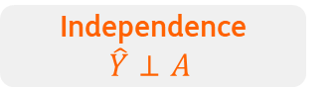


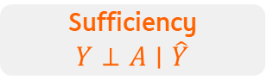

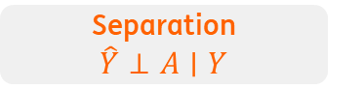

Fairness metrics: Statistical non-discrimination criteria
Absence of discrimination can be defined in terms of statistical expressions that equalise some group-dependent statistical quantity across different groups
Independence $\hat{Y}⊥A$
Separation $\hat{Y}⊥A∣Y$
Sufficiency $Y⊥A∣\hat{Y}$
Independence (or statistical parity) – This criteria aims to achieve equal acceptance rates across different demographics.
Prevalence
TPR = $\frac{TP}{TP + FN}$
PPV = $\frac{TP}{TP + FP}$
$$\frac{TP+FP}{TP+FP+TN+FN}$$
FPR = $\frac{TN}{FP+TN}$
NPV = $\frac{TN}{TN+FN}$
Separation (or equalized odds) – This just means that a “good” female should have as much chance of approval as a “good” male does. And, a “bad” male should have as much chance of rejection as a “bad” female does.
Cut-off-dependent metrics
Equalised odds: Equal error rates across groups
Actual
Bad loan
Actual
Good loan
Predicted
Good loan
True Positives
False Positive
Sufficiency (or positive predictive parity) – This requires to have equally accurate acceptance criteria across groups.
The lender (e.g. a Bank)
Predicted
Bad loan
False Negative
True Negative
10

Slide 11
Cut-off agnostic metrics
Model predictions can be challenged from a fairness perspective before they are used for classification. In this case, we pay attention to the distribution of the scores across groups.
Compare sub-groups score distributions
Difference
Central tendency comparison
Density
Female
Male
Cumulative distribution comparison
Distance between distributions
Decile comparison in scores
Scores
11

Slide 12



Where do biases come from?
The causes of bias usually come from within the process (data, techniques, features, etc)
Historical Bias
Over-time, certain groups could have been marginalized – their access to credit could have been limited; this may cause for ex, differences in target rates leading to potential perpetuation of such biases.
Representation Bias
It is possible that the modelling data may not represent all groups equally. In such cases of majority-minority bifurcation, models may do better for the majority in favour of achieving higher overall accuracy (often the goal of training).
Proxy Variables
Even when we do not have sensitive attributes such as gender, race, country of origin, religion, etc, in our models - we could still be including certain features that could associate with sensitive groups. Using such variables is an equal source of model discrimination.
“The Amazon recruitment model even penalized the word ‘woman’, reflecting the unfair practice of rejecting women in favour of men.”
“ImageNet is a large dataset that is used for image recognition. Since most of the pictures come from North America and Europe, the models trained on such a data do poorly for people from Asian countries.”
“Wherever you live in Cape Town, South Africa, your address is very indicative of your race. Zip codes in a model could result in racial discrimination. It is obvious that someone’s location should not change their risk just like race won’t”

Slide 13

How to mitigate bias in models?

Slide 14
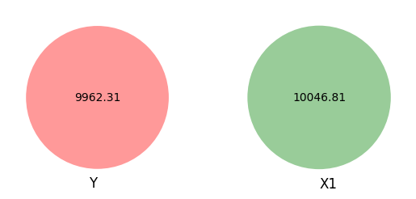
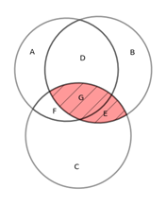
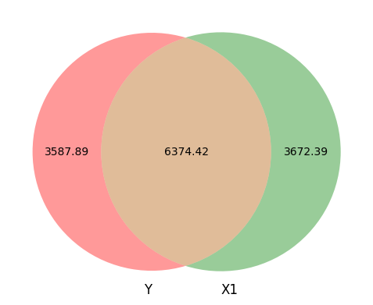
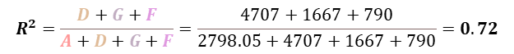
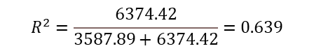
Suppress the protective attributes
A simply proposed solution to remove protective attributes may not be effective
Let’s start with a short story
“In the 1950s, the Boston Symphony Orchestra instituted “blind” auditions to combat implicit bias against women. They had hoped to be able to successfully put candidates behind a screen (so that gender is not visible) to eliminate any biased judgments. To the surprise of many, this initial “blindness” policy was not as blind as expected. A candidate’s gender was still showing up in the sound of their shoes (such as click of high-heels) as they walked behind the screen. This sound became a proxy for gender, and rendered the exercise fruitless.”
Explanatory 1 – sensitive attribute
Explanatory 1 – sensitive attribute
Explanatory 2 – non sensitive attribute
Target variable
Target variable
On fitting a model Y ~ X1, we have
X2
 | Sum of squares | df | F | PR(>F)
X1 | 6374.42 | 1 | 17762.94 | 0
Residual | 3587.88 | 9998 | - | -
If X1 and X2 are correlated:
Y
X1
R² for combined model
$$R^{2}=\frac{D+G+F}{A+D+G+F}=\frac{4707+1667+790}{2798.05+4707+1667+790}=0.72$$
Let’s visualize
$$R^{2}=\frac{6374.42}{3587.89+6374.42}=0.639$$
Area G shows the variation shared by both X1 and X2 with Y. As a result, even if make our model blind to X1, our model still has some information of X1 from its proxy X2 (which is not a sensitive attribute).
X2
Variation in Y explained by X1

Slide 15

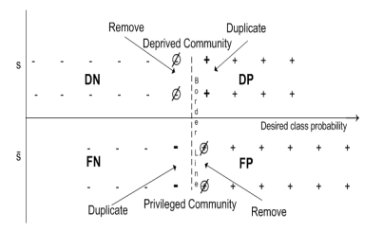
Approaches to Bias Mitigation: Pre-Processing
Remove bias from data – bring the diverse groups closer in representation
Sex | Default | Count | Class Prob.
Female | Y = 1 | 400 | 0.40
Female | Y = 0 | 600 | 0.60
Male | Y = 1 | 200 | 0.10
Male | Y = 0 | 1,800 | 0.90
Base Rate (+) $⇒ \frac{\left(600+1,800\right)}{\left(650+350+1,800+200\right)}=0.80$
Assign weights to bring the event rates to parity.
Suppression – Remove sensitive features and all the correlated ones.
Kamiran & Calders (2012)
Calmon et al. (2017)
Zemel et al. (2013)
Feldman et al. (2015)

Slide 16
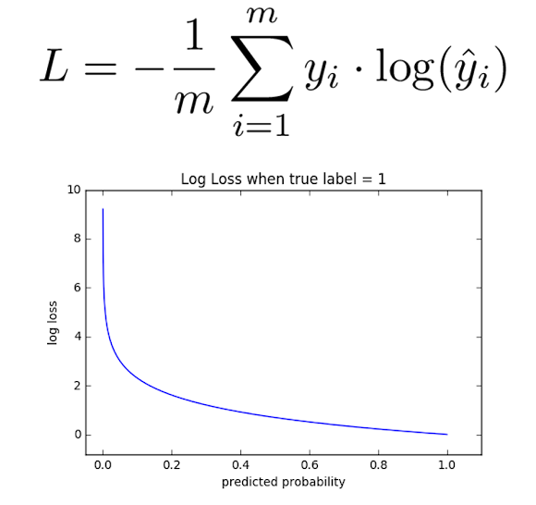
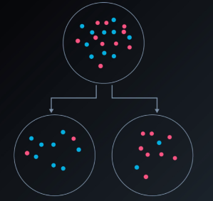
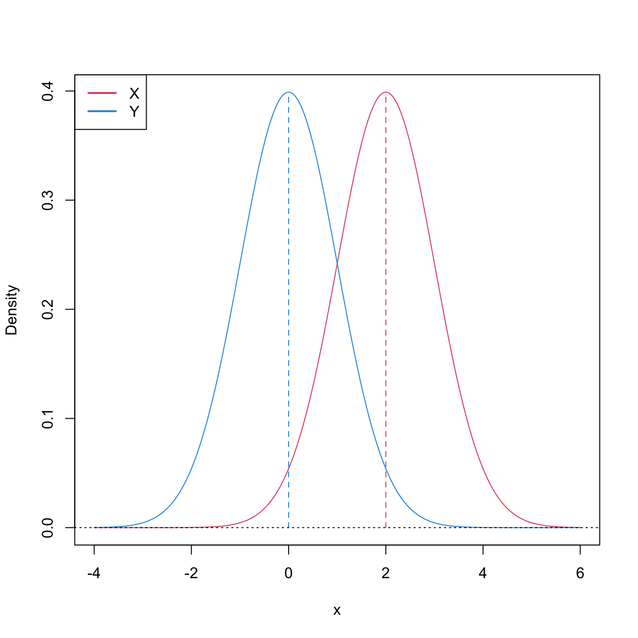
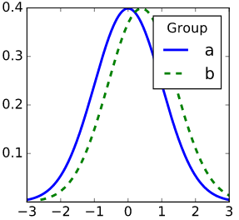
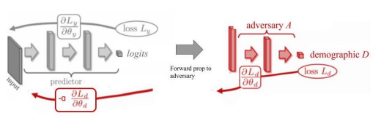
Approaches to Bias Mitigation: In-Processing (1/2)
Modify the training process to get a fair model (more or less)
How does training on biased data lead to a biased model?
Age of Credit History < 10 years
1. Biased Data
2. Train – Min Loss
3. Biased Features
4. Biased Model
What can we change?
Age of Credit History < 5 years
1. Biased Data
2. Dual Obj: Min Loss & learnt Bias
3. Un-Biased Features
4. Un-Biased Model

Slide 17
Approaches to Bias Mitigation: In-Processing (2/2)
Modify the training process to get a fair model (more or less)
How does training on biased data lead to a biased model?
Age of Credit History < 10 years
1. Biased Data
2. Train – Min Loss
3. Biased Features
4. Biased Model
What can we change?
Age of Credit History < 5 years
1. Biased Data
2. Dual Obj: Min Loss & learnt Bias
3. Un-Biased Features
4. Un-Biased Model
* Fair Adversarial Debiasing
1. Zhang et al. (2018)

Slide 18


Approaches to Bias Mitigation: Post-Processing
Transform the predicted labels of appropriately chosen samples to meet group fairness requirements
DIA: (2/6) / (6/9) = 50%
DIA: (3/6) / (5/9) = 90%
Privileged
Protected
* Reject Option Classification
Kamiran et al. (2018)
Hardt et al. (2016)
Pleiss et al. (2017)

Slide 19

Questions?
Let’s move to our practical exercises on the following GitHub repository:
https://www.github.com/josecaloca/validation-of-fair-classifiers/

Slide 20
References
Calmon, F. P., Wei, D., Ramamurthy, K. N., & Varshney, K. R. (2017). Optimized Data Pre-Processing for Discrimination Prevention [Preprint]. arXiv preprint arXiv:1704.03354.
Feldman, M. (2015). Computational Fairness: Preventing Machine-Learned Discrimination [Doctoral dissertation, Haverford College, Department of Computer Science]. Haverford College. http://hdl.handle.net/10066/17628
Hardt, M., Price, E., & Srebro, N. (2016). Equality of Opportunity in Supervised Learning [Preprint]. arXiv preprint arXiv:1610.02413.
Kamiran, F., & Calders, T. (2012). Data preprocessing techniques for classification without discrimination. Knowledge and Information Systems, 33(1), 1-33. https://doi.org/10.1007/s10115-011-0463-8
Kamiran, F., Mansha, S., Karim, A., & Zhang, X. (2018). Exploiting reject option in classification for social discrimination control. Information Sciences, 425, 18-33. https://doi.org/10.1016/j.ins.2017.09.064
Pleiss, G., Raghavan, M., Wu, F., Kleinberg, J., & Weinberger, K. Q. (2017). On Fairness and Calibration [Preprint]. arXiv preprint arXiv:1709.02012.
Zemel, R., Wu, Y., Swersky, K., Pitassi, T., & Dwork, C. (2013). Learning Fair Representations. In Proceedings of the 30th International Conference on Machine Learning (pp. 325-333). Sanjoy Dasgupta and David McAllester (Eds.). PMLR, Vol. 28, No. 3.
Zhang, B. H., Lemoine, B., & Mitchell, M. (2018). Mitigating Unwanted Biases with Adversarial Learning [Preprint]. arXiv preprint arXiv:1801.07593.

